Slide 1
Hi 👋
Everyone

Slide 2
Mastering the MLSA Program: From MLSA NEW Member to a GOLD Leader ✨
Abdul Rehman (Gold MLSA)

Slide 3
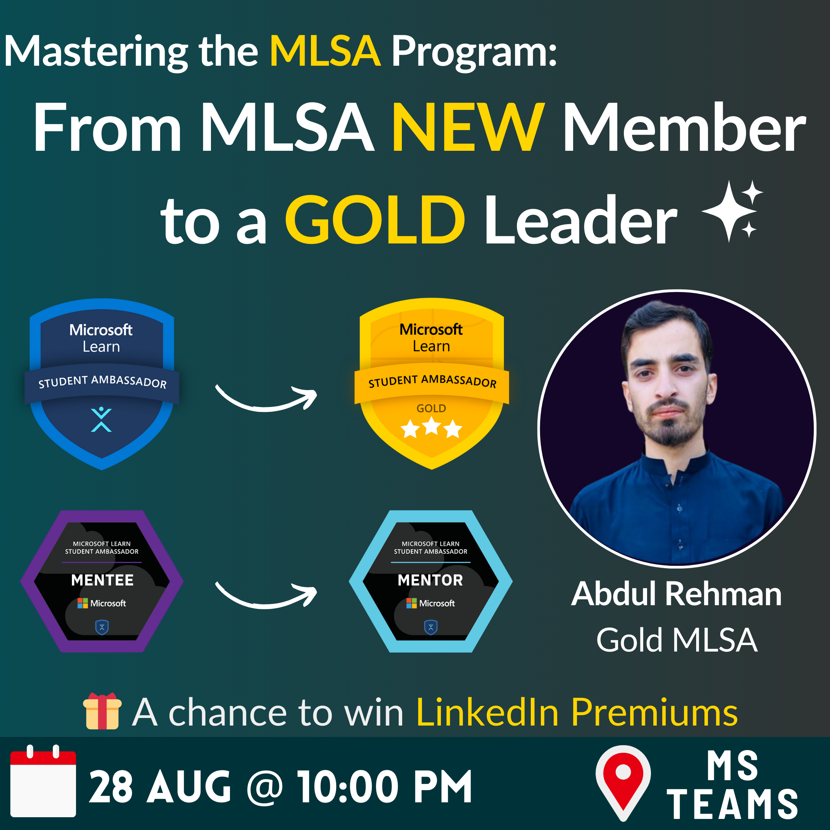

Slide 4
Today’s Event Agenda
Complete information of the Program
Proven Roadmap to Success
Insider Tips & Strategies
Exclusive MLSA Benefits
Networking & Mentorship
Interactive Q/A Session
Giveaway of LinkedIn Premium Vouchers

Slide 5
From knowing about MLSA Program to a NEW MLSA
What is Microsoft Learn Student Ambassador Program ?
How to apply for MLSA Program and eligibility ?
How to Join Discord Channel of MLSA and link accounts for Roles ?
Unique Contributor ID / Sharing ID.
MLSA Program Requirements for newly registered student. (2)
How and in how much time do we have to complete these Requirements?
MLSA Program Handbook (The Ultimate Guide)
How can we see or check the unique / preferred visitors through our Contributor ID ?
That’s it, You’re now a Microsoft Learn Student Ambassador :)

Slide 6
From NEW MLSA to becoming a BETA MLSA
MLSA Congratulations email -- SA email & pass, MLSA Profile, official onboarding.
What to do after becoming MLSA for a next milestone ?
Access Microsoft Learn Platform with Student Ambassador’s email.
BETA MLSA Requirements (Technical Training, Host Event)
Quarterly Program Requirements for all MLSAs (NEW, ALPHA, BETA, Gold).
Participate in Peer Mentorship Program as a Mentee.
Regularly attend the MLSA Monthly Ambassadors Call for new updates and News.
Connect with junior and senior MLSAs.
What if we face any difficulty throughout our MLSA journey (SA-Coordinator).
That’s it, You’re now a BETA Microsoft Learn Student Ambassador :)

Slide 7
From BETA MLSA to becoming a GOLD MLSA
Host Events, CSCs regularly.
Participate in Events, and CSCs with your student ambassador’s email.
Participate in Peer Mentorship Program as a Mentor.
Participate in MLSA AI Projects as a Team Lead or a Member.
Continue your activities like create videos, posts, publish articles, help junior MLSAs.
Regularly attend the MLSA Monthly Ambassadors Call for new updates and News.
Must meet the Gold MLSA criteria.
Request for the recommendations from Gold Ambassadors.
That’s it, You’re now a Gold Microsoft Learn Student Ambassador :)

Slide 8
What’s after becoming a Gold MLSA ?
Gold is a highest milestone in MLSA Program.
Unlock all the benefits/resources from MLSA New to Gold Level.
Quarterly Program Requirements for all MLSAs (NEW, ALPHA, BETA, Gold).
Continuously engage with the Program to be eligible for MVP Program.
Help and Support juniors in achieving their next milestones.
Have a chance to take part as a speaker in Microsoft events (as a speaker).
Direct Mentorship and Support from MLSA Program Coordinators.

Slide 9
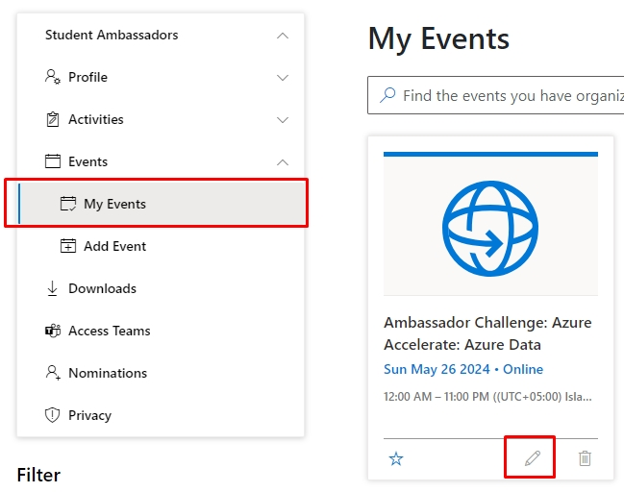
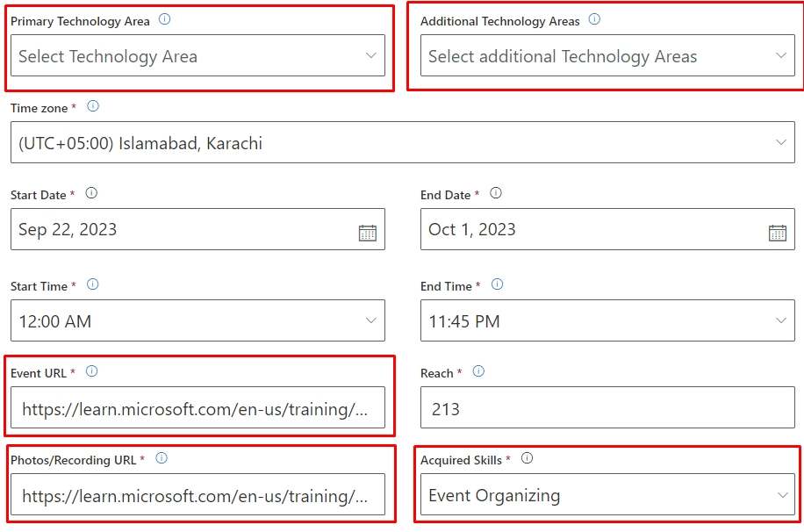
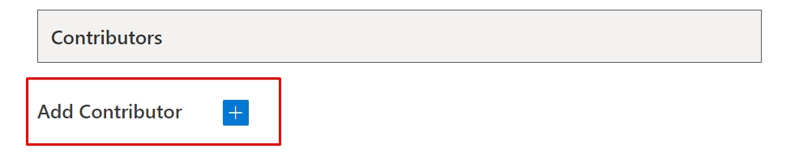
Adding Event on MLSA Profile

Slide 10
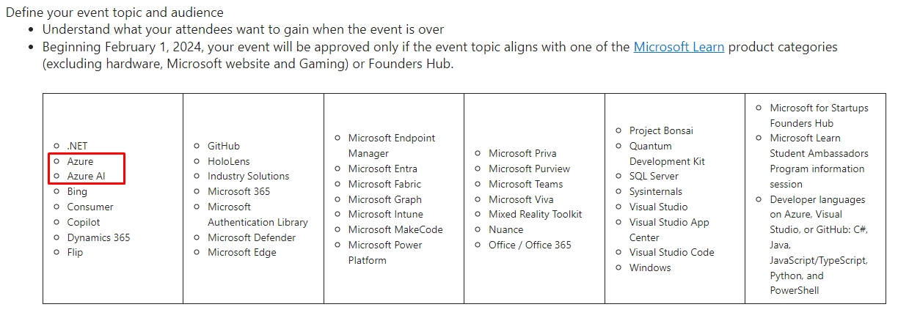
Eligible Topics for Event

Slide 11
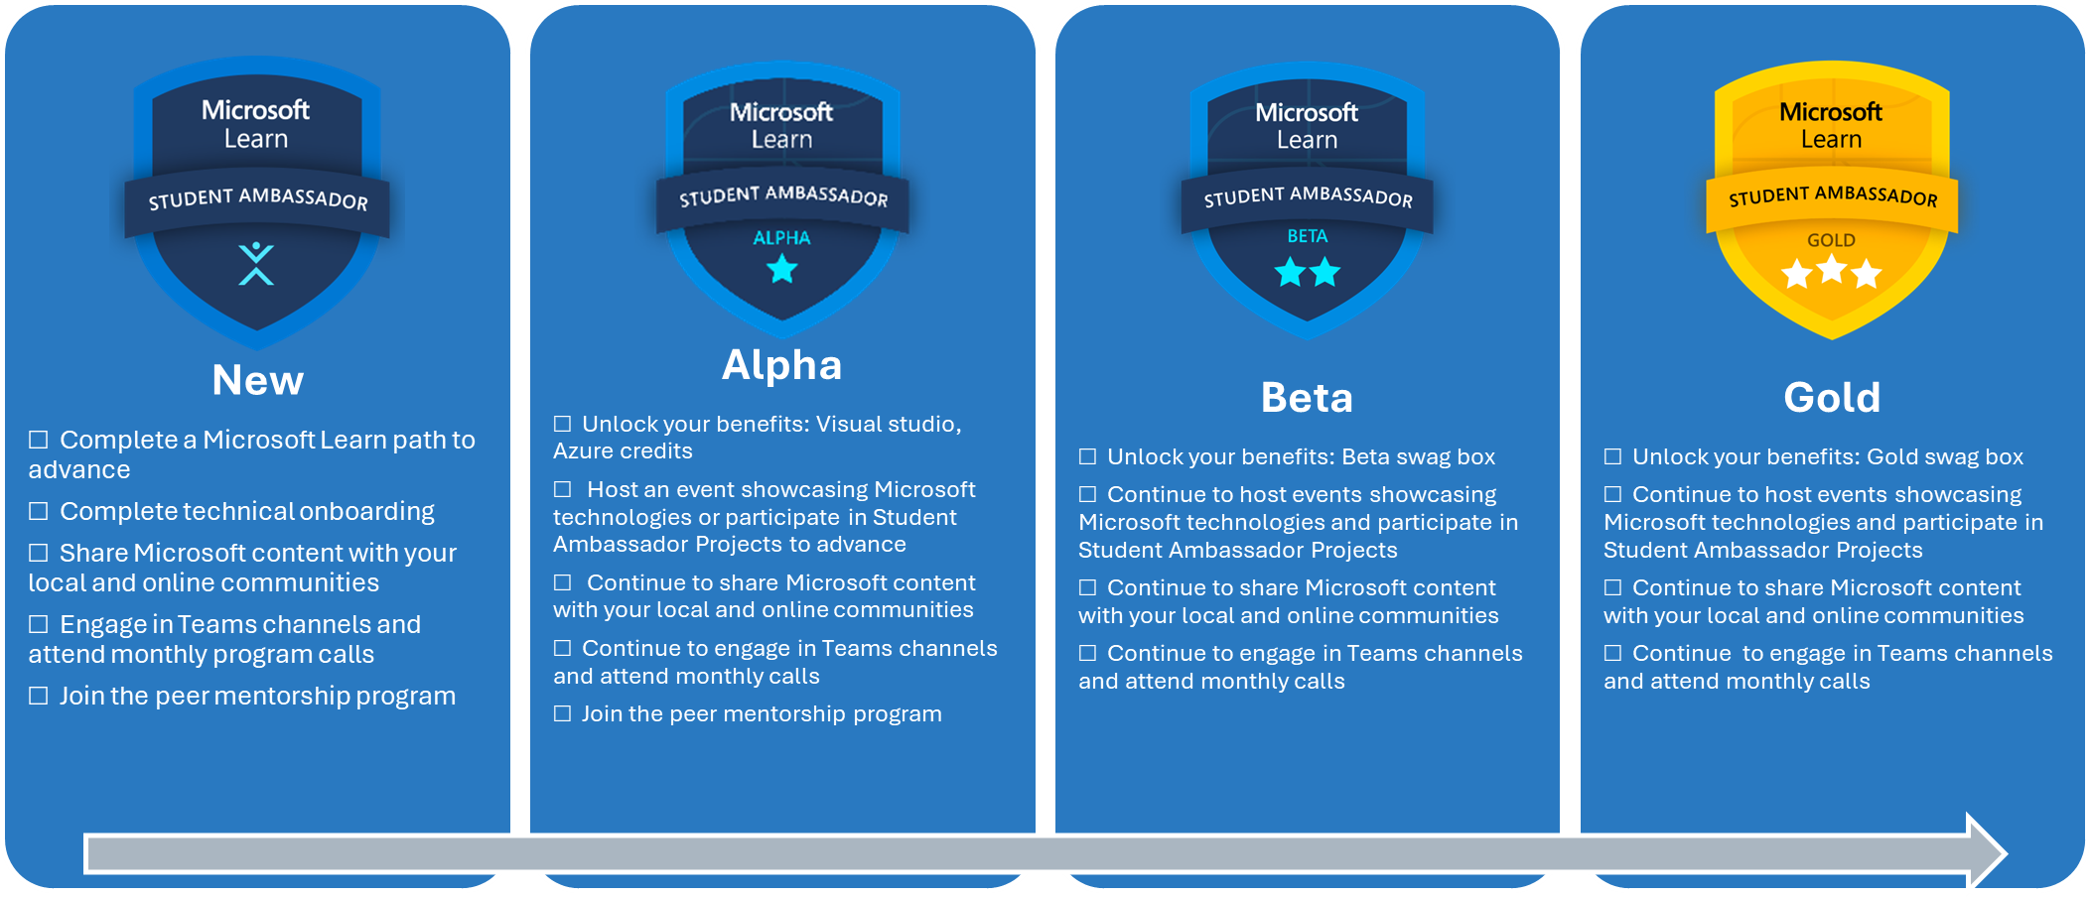
MLSA Milestones

Slide 12
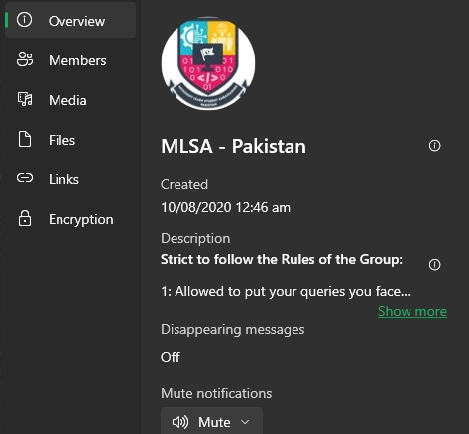
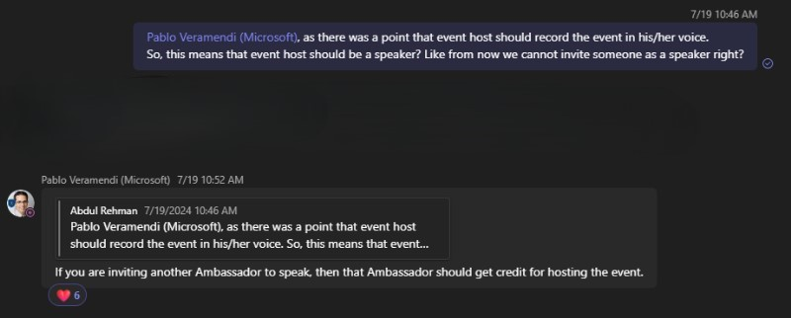
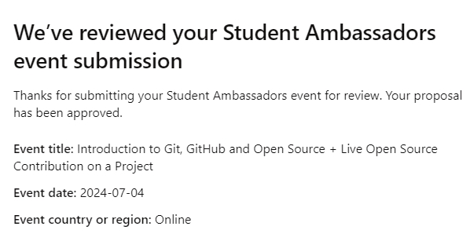
Some helpful Screenshots

Slide 13
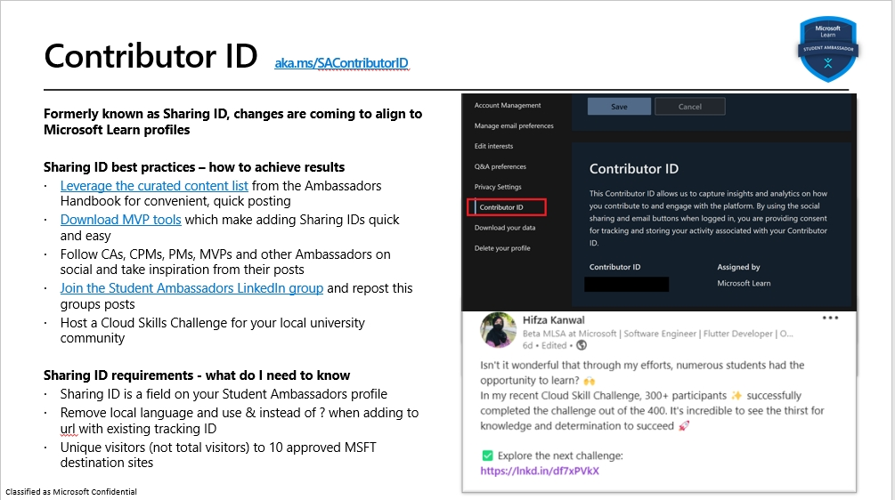
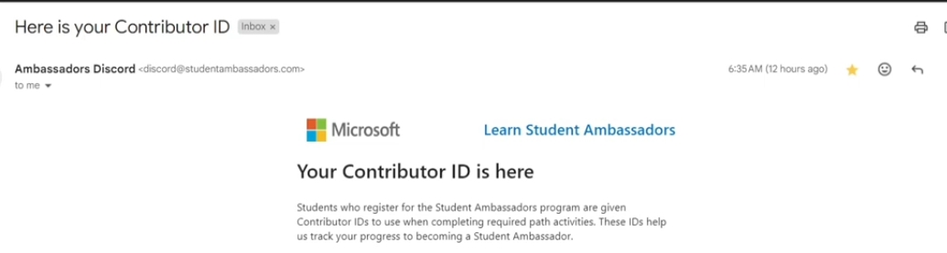
Contributor ID

Slide 14
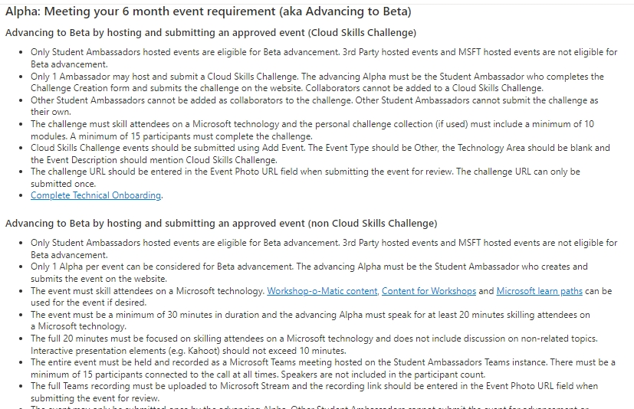
Some helpful Screenshots

Slide 15
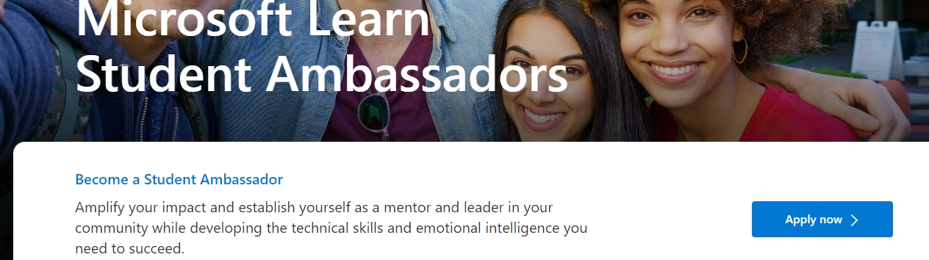
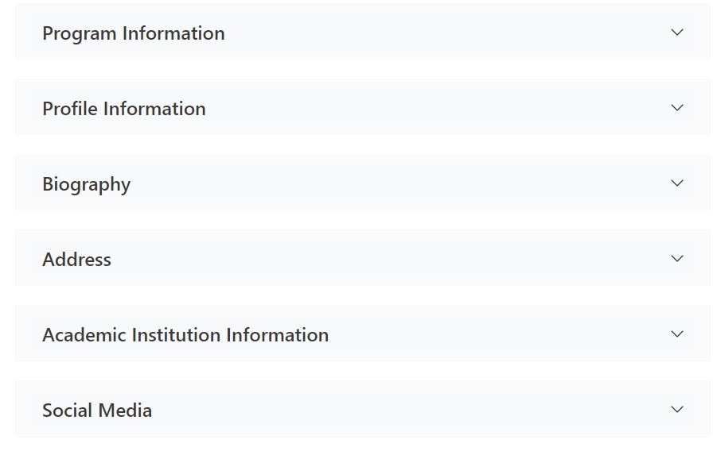
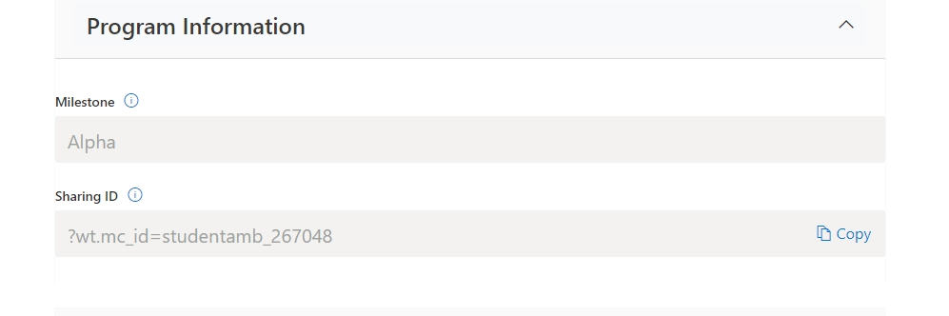
MLSA Profile - Information

Slide 16
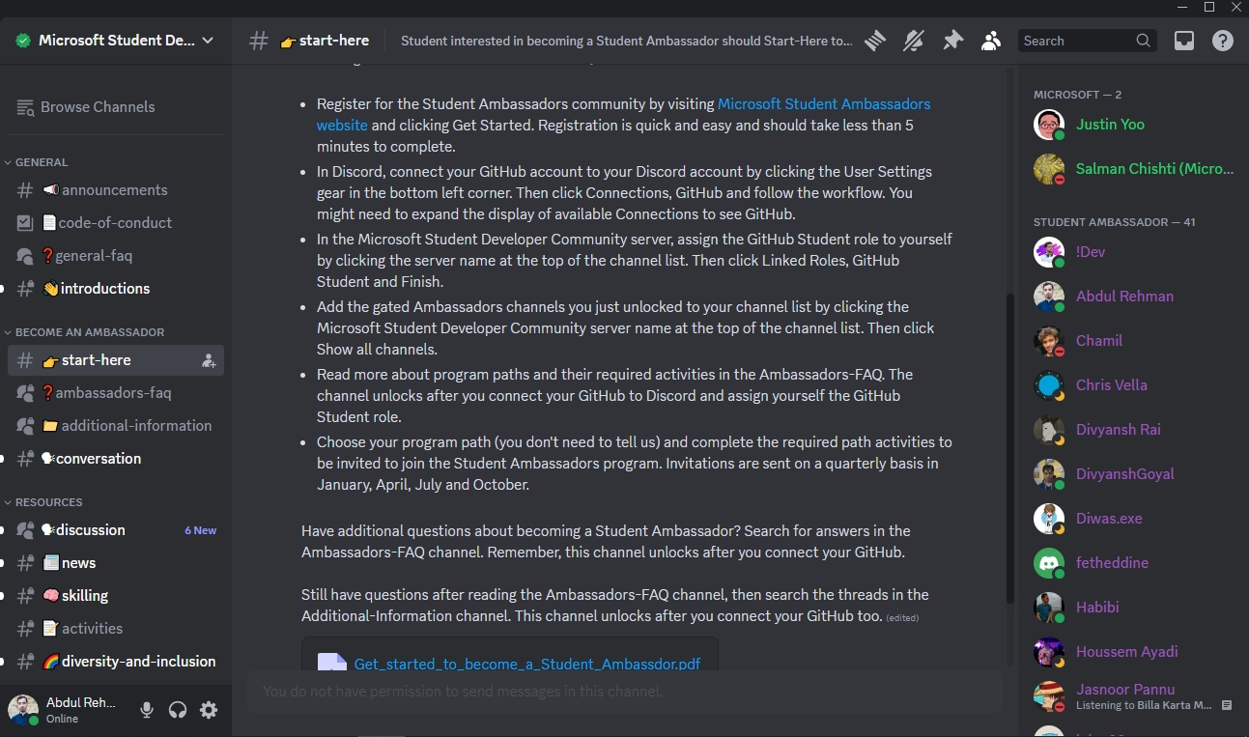
MLSA Discord

Slide 17
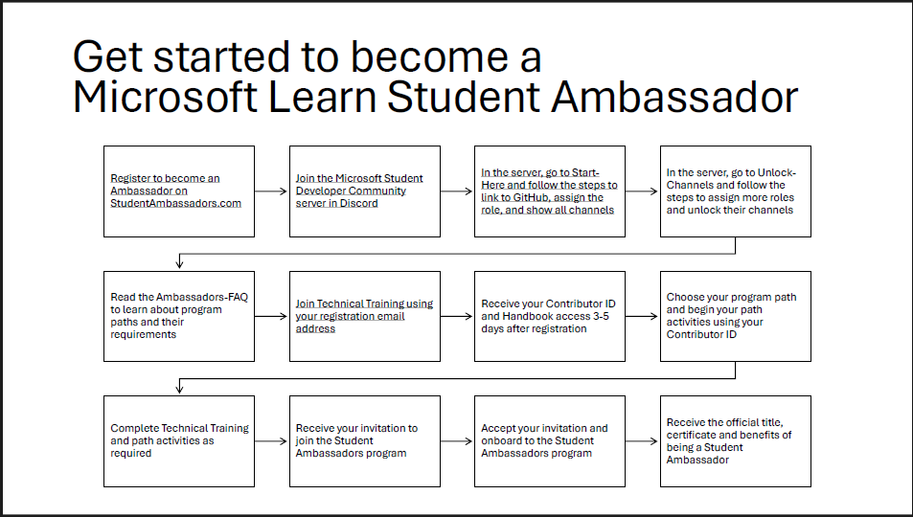
MLSA Complete Roadmap for beginners

Slide 18
Helpful Resources and Links:
Official Website of MLSA Program
MLSA Program Handbook
YouTube Channel for helpful videos (Abdul Rehman)
MLSA Contributor IDs Leaderboard
MLSA Quarterly Requirements Dashboard
MLSA - Advancing Milestones
MS Learn Platform
MLSA – Event Certificate Generator
Microsoft Event Slides Template Updated
MS for Startups Founders Hub Official Website
Free Benefits and Subscriptions of Azure, MS365 etc

Slide 19
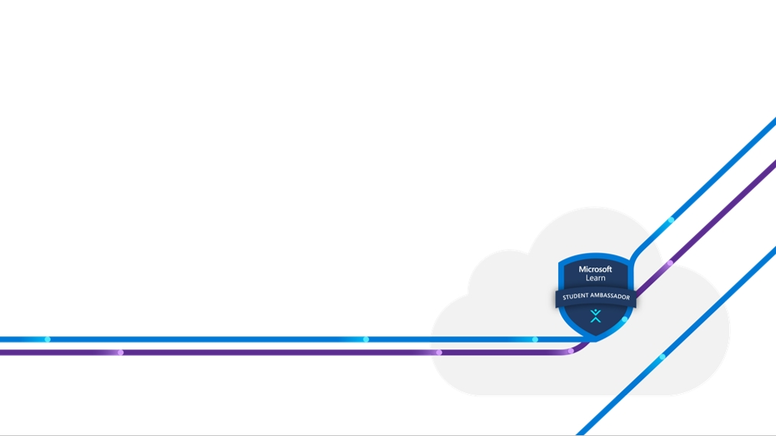
Q & A Session
?

Slide 20







Thank You :)
I will be glad to connect with you
: https://www.linkedin.com/in/abdulrehman0/
: https://linktr.ee/devabdulrehman
: https://twitter.com/devabdulrehman
: https://medium.com/@abdulrehman0
: https://github.com/abdulrehmanghub
: https://www.arcommunity.me
Abdul Rehman
Gold MLSA

Slide 21
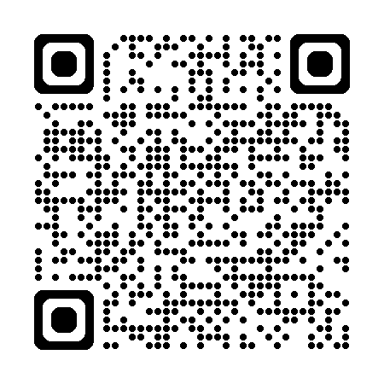
Survey
Take our two-question survey

